Slide 1
Excel Internal assessment 1
Yuvan Barathi C

Slide 2
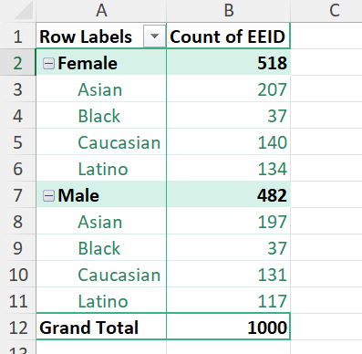
Summary of gender and ethnicity distribution
Question 1

Slide 3
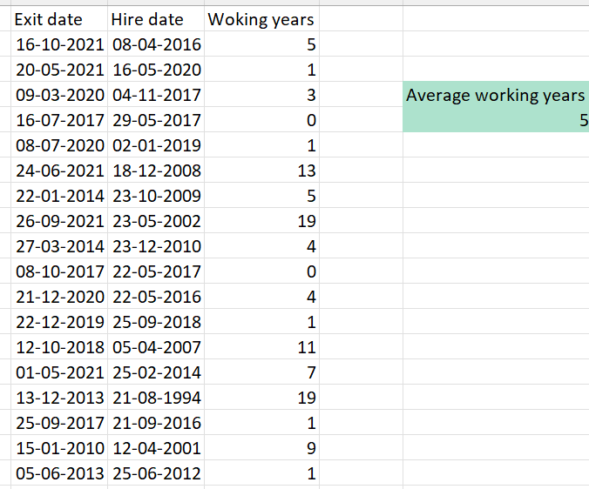
Average working years before exit
Question 2

Slide 4
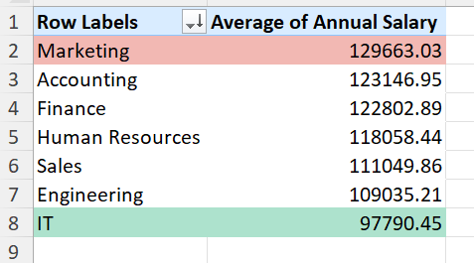
Average salaries based on dept. Marketing has significantly bigger salary than IT
Question 3

Slide 5
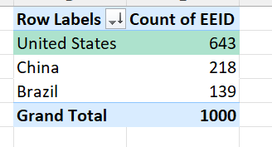
No. of employees based on countries. US has highest no.of employees
Question 4

Slide 6
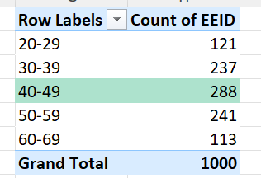
40-49 is the most common age group
Question 5

Slide 7

Average of bonus percentage
Question 6

Slide 8
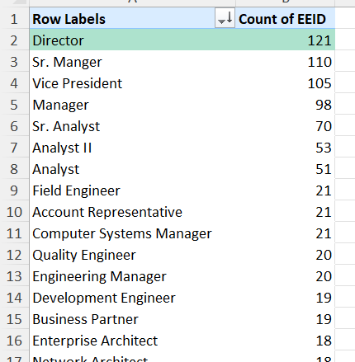
Director title has highest no.of occurences
Question 7

Slide 9
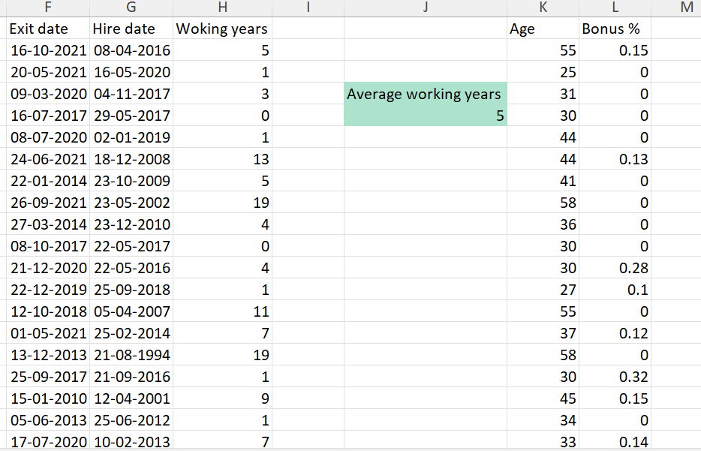
Age and Lack of bonus seems to be the reason for exits of employees
Question 8

Slide 10
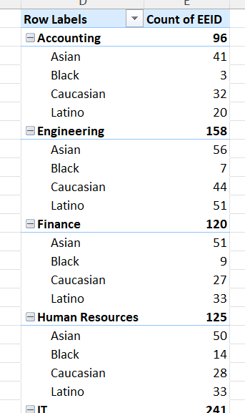
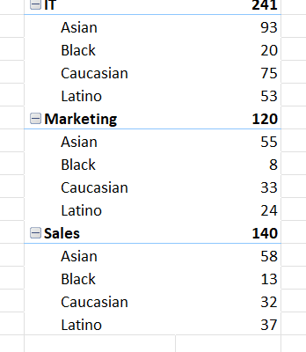
Sales team seems to be comparatively diverse in terms of ethnicity
Question 9

Slide 11
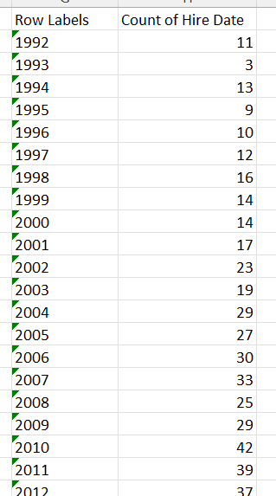
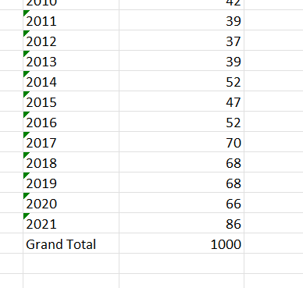
Rate of employment has increased in recent years
Question 10

